Slide 1

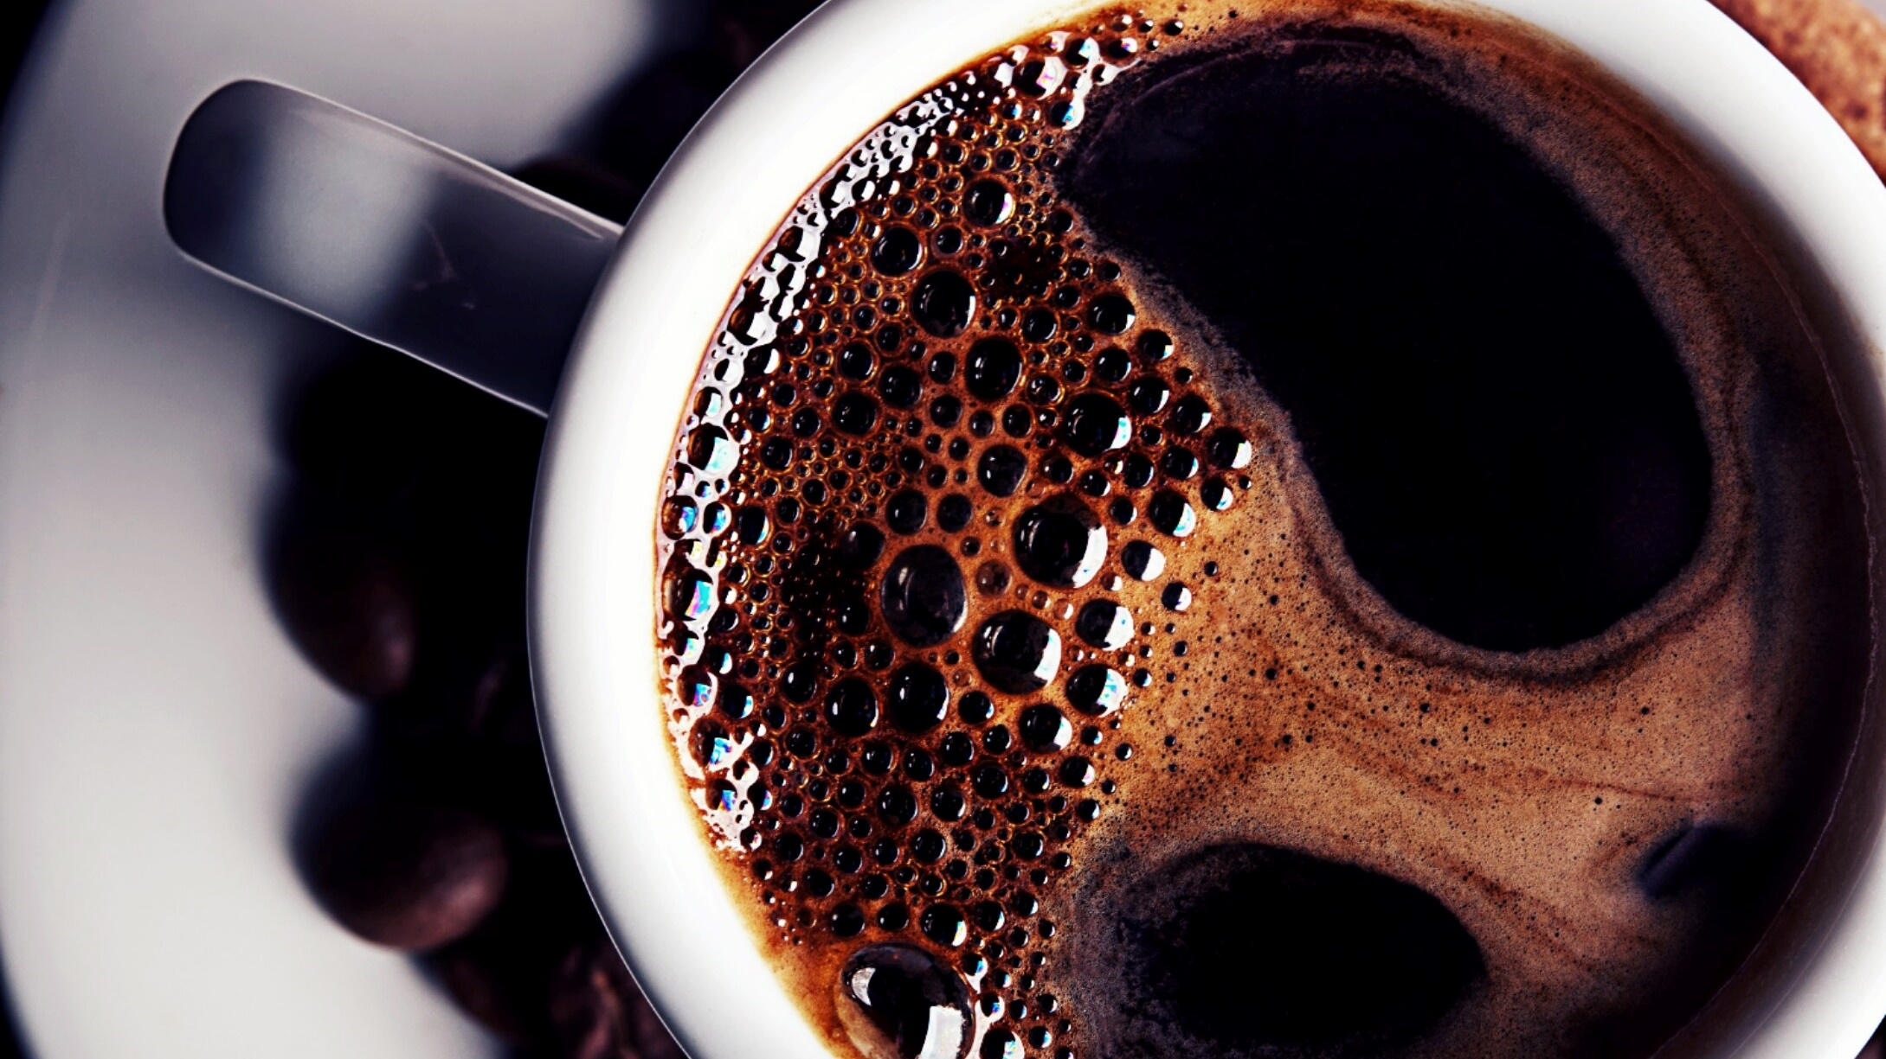
The Battle of Neighborhoods
IBM Applied Data Science Capstone Project
Albert T Chung

Slide 2
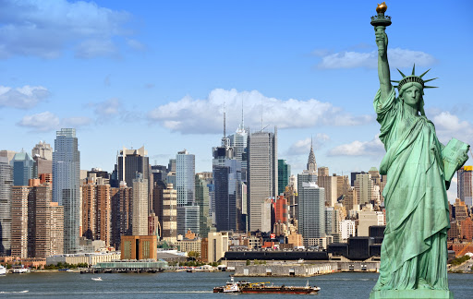
Travel agency is planning a coffee themed tour in New York. Where is the best place to visit as much coffee shop in a limited time?

Slide 3
Target Audience: People who love coffee and travel agencies would be interested in this project.
Data from Foursquare and New York data is used which includes neighborhoods, boroughs, latitudes, longitudes and ratings information.

Slide 4
Data is collected from http://cocl.us/new_york_dataset and structured into data frame #1.
Coffee shop per borough data frame #2 is created using Foursquare api.
Identify borough with highest number of coffee shops.
Created data frame # 3 that only contain Manhattan info.
Ratings of coffee shop data frame #4 is created using Foursquare api.
Merge data frame #3 and #4 to plot location and ratings on map.

Slide 5
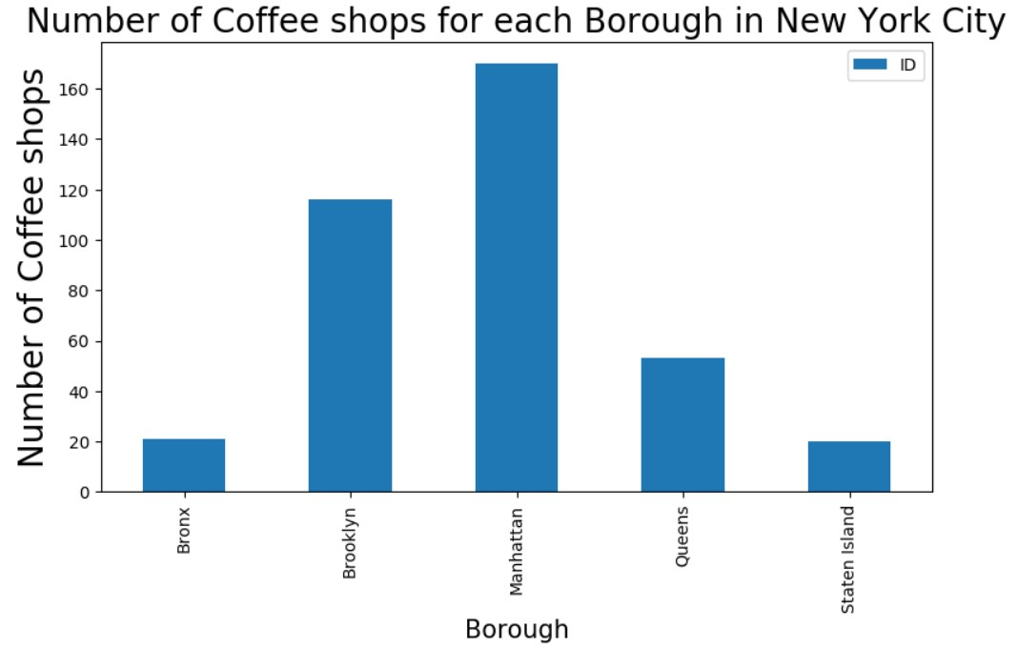
Manhattan has the most coffee shops in New York.

Slide 6
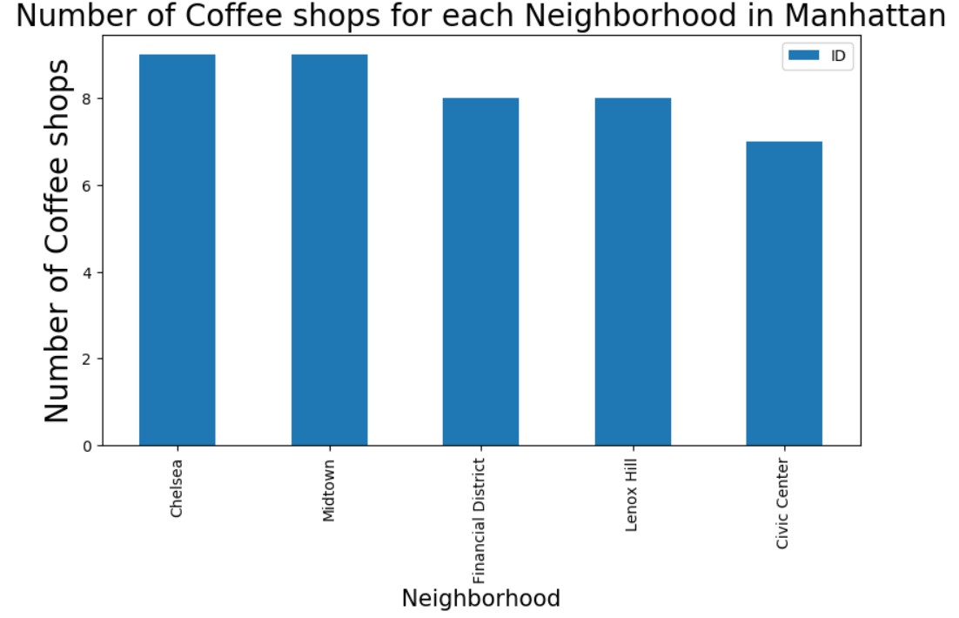
Chelsea and Midtown has the most coffeeshops per neighborhood

Slide 7
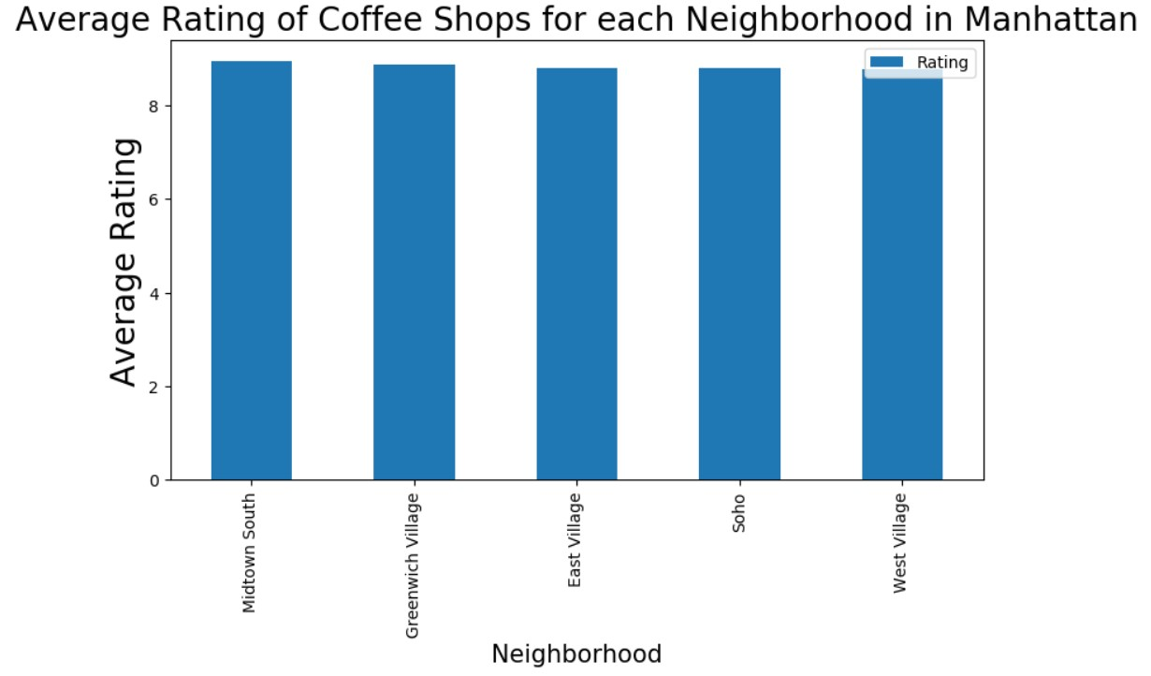
Midtown South has the highest rating.

Slide 8
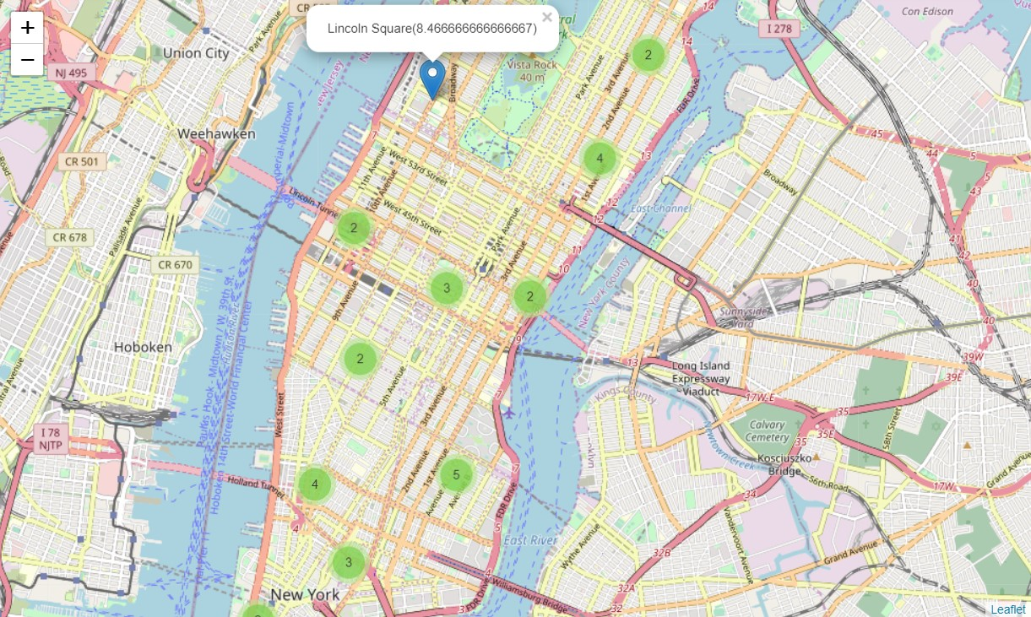
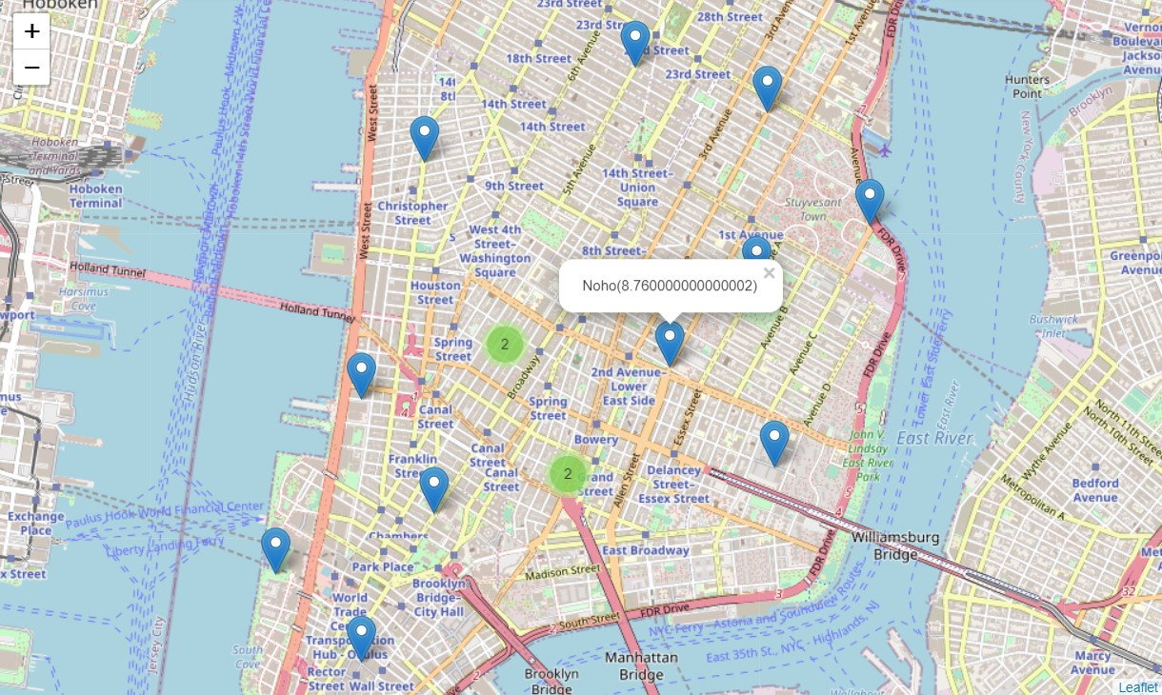
Coffee shops with rating greater than 6 is marked.

Slide 9
Manhattan has the highest number of Coffee shops.
Chelsea and Midtown has the most number of shops with high rating.
Ratings are only collected from Foursquare.
Could improve accuracy of ratings with other data source.

